Slide 1
Streaming Insights: A Data-Driven Exploration of Netflix Shows Across Time, Genres, and Regions
With the explosion of on-demand entertainment, Netflix has become a dominant global force in streaming, hosting a massive library of TV shows and movies. But have you ever wondered what types of content Netflix offers most, how its content has evolved over the years, or which countries dominate its library?
In this project, we explore a public dataset of Netflix content to uncover trends in the types of shows, release timelines, content durations, genres (listed_in), countries, and key contributors like directors and cast. We investigate questions like:
i; What type of content (TV Shows or Movies) dominates the platform?
ii; How has content production changed over the years?
iii; Which countries contribute the most to Netflix’s library?
iv; What are the most popular genres listed?
v; Are there key patterns among top directors or star casts?
By transforming and visualizing this data, we aim to tell a compelling story of Netflix’s growth, global reach, and content strategy over time providing insights not only for analysts and media professionals, but for anyone curious about how one platform has reshaped modern entertainment.

Slide 2
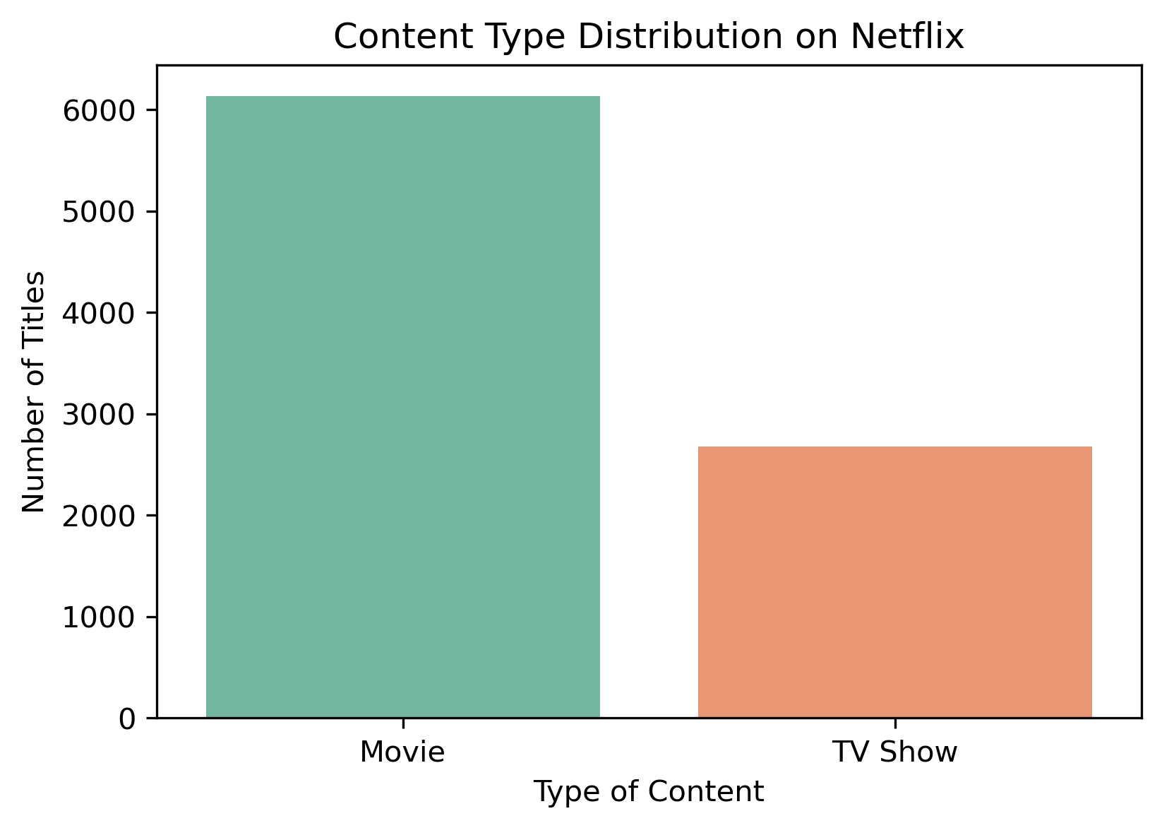
Insight 1: Content Type Distribution
The analysis reveals that Movies overwhelmingly dominate Netflix’s content library, with approximately 6,000 titles, compared to around 3,000 TV Shows. This indicates a strong focus on movie content production and acquisition by the platform.

Slide 3
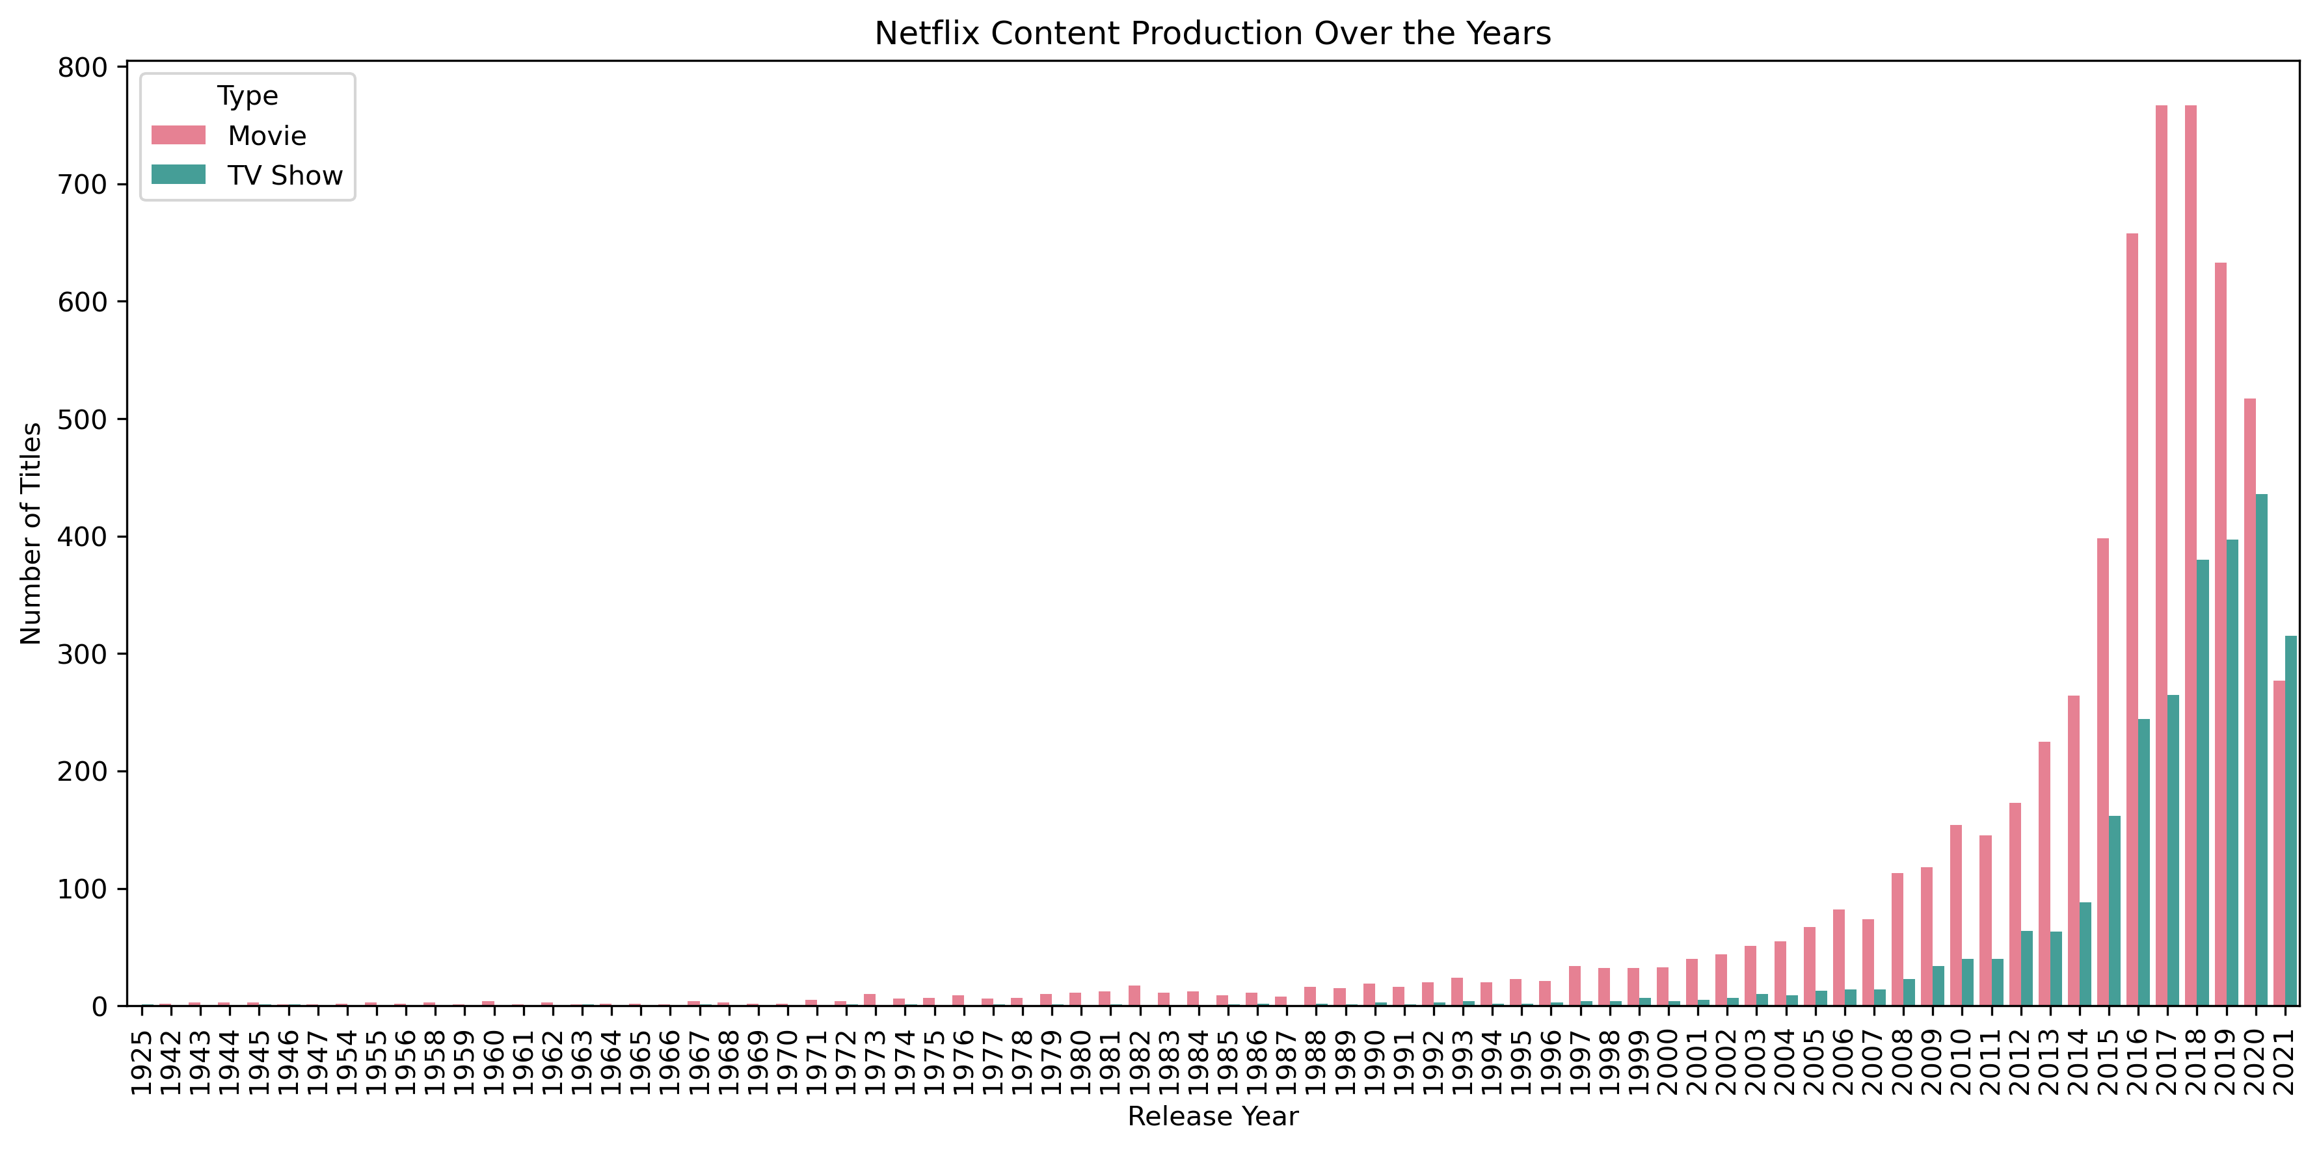
Insight 2: Content Production Over the Years Netflix has consistently increased its content output over the years, with a noticeable upward trend in production as we approach recent years. The year 2018 stands out as the peak year, recording the highest number of content releases. Additionally, Movies consistently lead TV Shows in annual content volume, reinforcing their dominance on the platform.

Slide 4
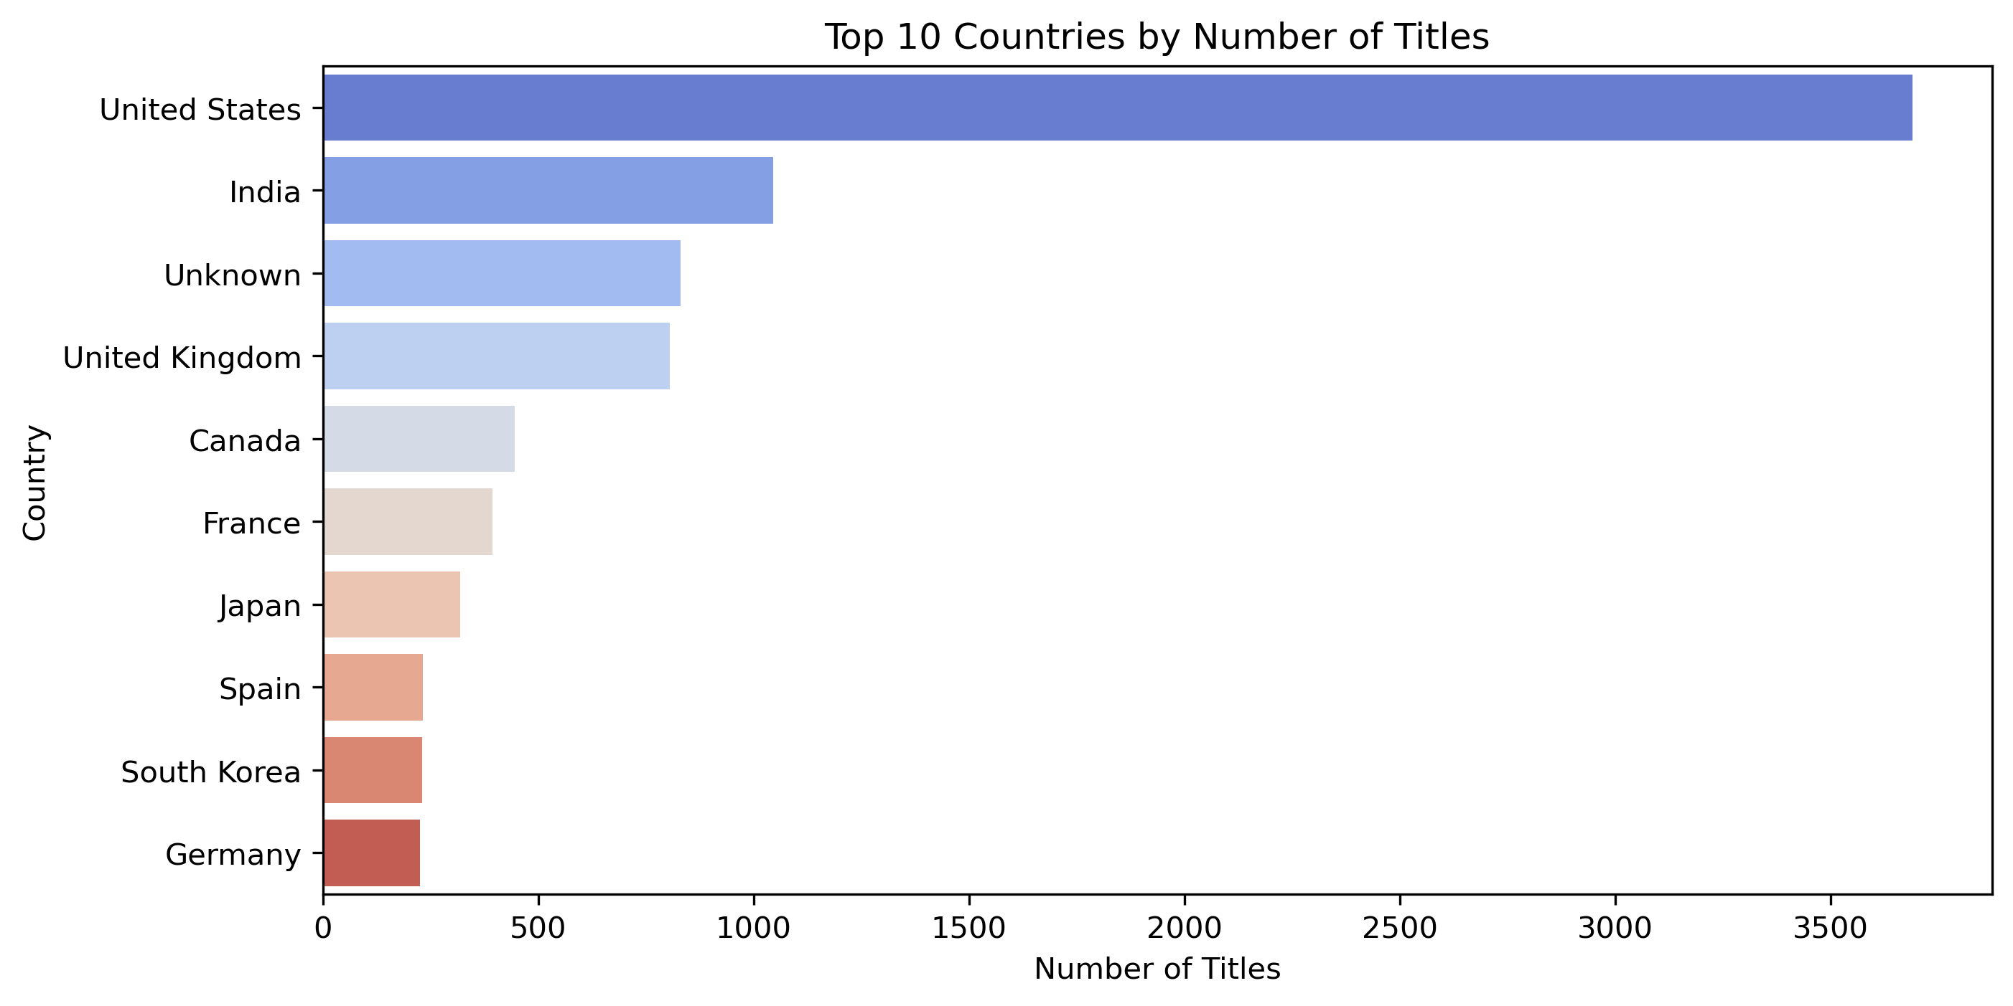
Insight 3: Top 10 Countries by Number of Titles The United States emerges as the leading contributor to Netflix’s library by a significant margin, followed by India. Interestingly, a large number of titles have unspecified origin, grouped under “Unknown,” which ranks third. This points to potential gaps in data recording or content categorization.

Slide 5
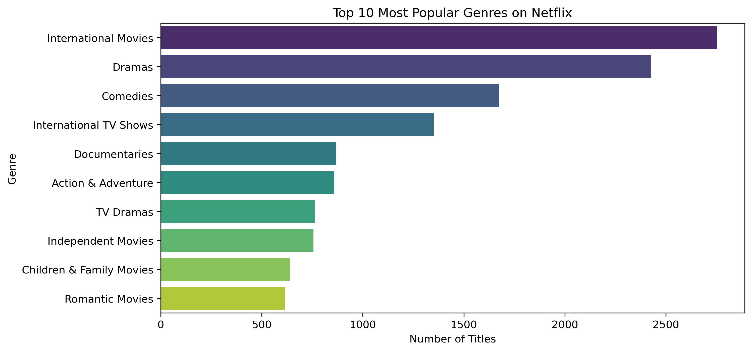
Insight 4: Top 10 Most Popular Genres Among the various genres listed, International Movies top the chart, closely followed by Dramas. This suggests that Netflix prioritizes global storytelling and caters to a diverse international audience with a strong interest in dramatic narratives.

Slide 6
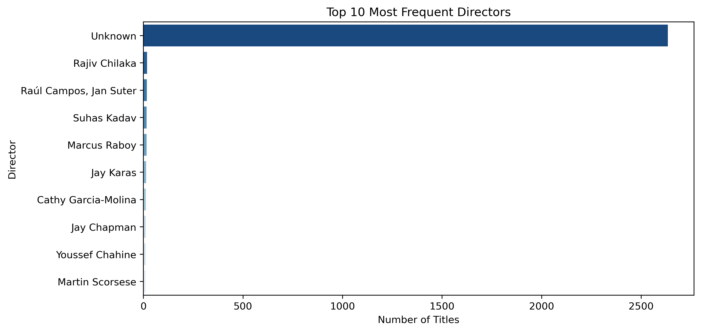
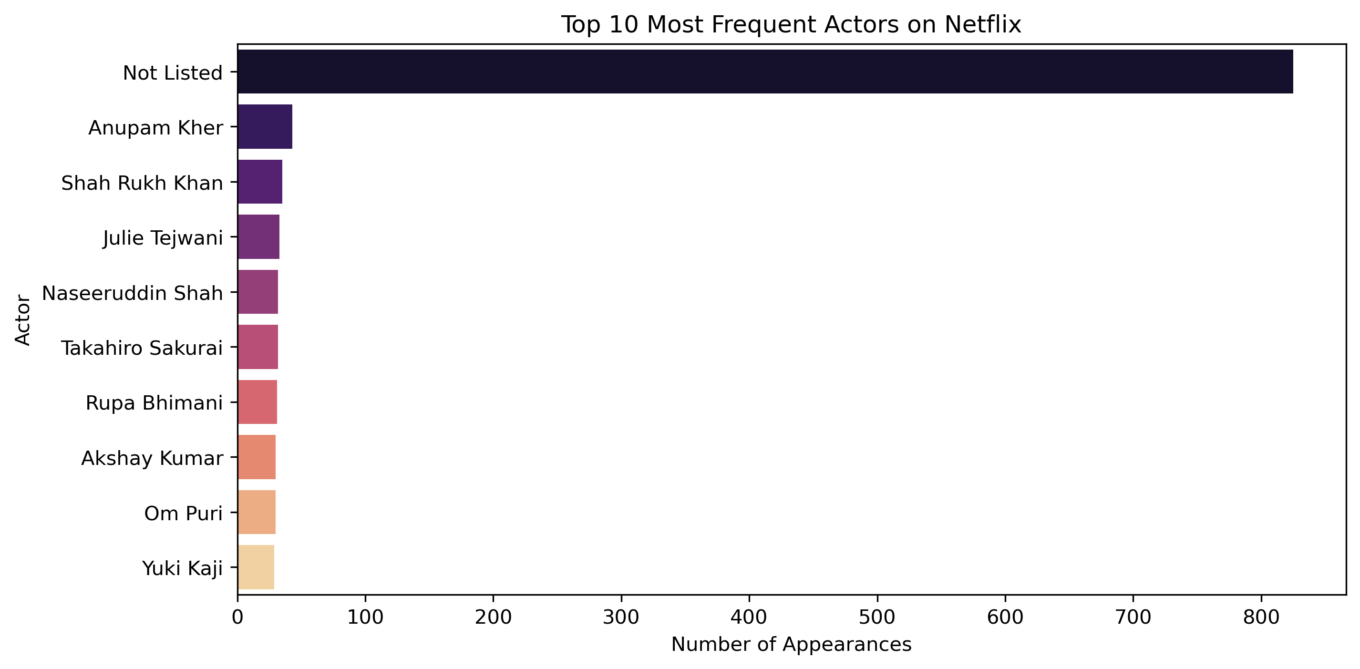
Insight 5: Top 10 Most Frequent Directors and Star Casts The data indicates that entries labeled “Unknown” or “Not listed” dominate the records for both directors and cast members, overshadowing named individuals by a large margin. This highlights a significant limitation in metadata completeness, which may affect detailed analysis of talent trends on the platform.

Slide 7
Conclusion & Implications
Netflix's content is dominated by Movies, with a sharp increase in production over the years, peaking in 2018. The United States leads in content contribution, followed by India, while International Movies and Dramas top the genre list. However, many records lack director and cast information, limiting deeper talent insights.
Implication:
Netflix is expanding globally with a strong movie-driven strategy, but improving data quality (especially around metadata) could unlock richer insights and better content recommendations.

